Slide 1


INFT 1012 Network Fundamentals
Week 11 – Topic Outline and Highlights

Slide 2
Outline
Introduction to IPv4 Subnetting– what and why?
Subnetting an IPv4 Network – how ?
Creating equal-sized subnets, i.e. basic subnetting (focus)
VLSM (brief)
Address planning and assignment

Slide 3
Readings
The PDF document titled “Readings-Subnetting-Examples” in week 10 Readings folder
Note: You may read Cisco NetAcad text Sections 11.4 to 11.9 of Module 11, but you are advised to use this set of slides and the above readings (subnetting examples) as the main source for learning this topic: IPv4 subnetting.

Slide 4
What is subnetting?
Subnetting is the process of segmenting a network (a range of IP addresses) into multiple smaller networks or IP address ranges
When talking about subnetting a network,
the original network or range of IP addresses to be subnetted is often called base network
The smaller networks or IP address ranges obtained are called subnetworks or subnets
Requirements of subnetting:
Addresses in different subnets must have different network bits (or equivalently different network addresses)
Addresses in same subnet must have same network bits (or equivalently same network addresses) and different host bits
The obtained subnets or address ranges must not overlap

Slide 5
What is subnetting?
Play slideshow to see animations
Example - Given base network:192.168.1.0/24
If we halve the base network, we can get two /25 subnets which satisfies the requirements stated on the previous slide.
192. 168. 1. 0
192. 168. 1. 00000000
192. 168. 1. 1
192. 168. 1. 00000001
…
…
192. 168. 1. 0/25
192. 168. 1. 126
192. 168. 1. 01111110
192. 168. 1. 127
192. 168. 1. 01111111
192. 168. 1. 128
192. 168. 1. 10000000
192. 168. 1. 129
192. 168. 1. 10000001
192. 168. 1. 128/25
…….
…….
192. 168. 1. 254
192. 168. 1. 11111110
192. 168. 1. 255
192. 168. 1. 11111111

Slide 6
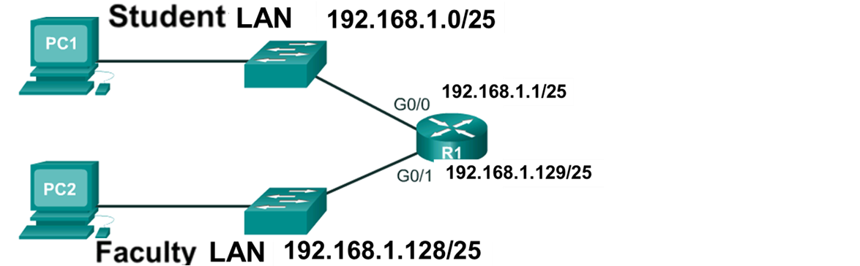
What is subnetting?
Communication across different subnets
Routers are needed for devices on different subnets to communicate
Each router interface must have an IPv4 host address within the subnet to which the router interface is connected
Devices on a subnet use the router interface attached to their LAN as their default gateway

Slide 7
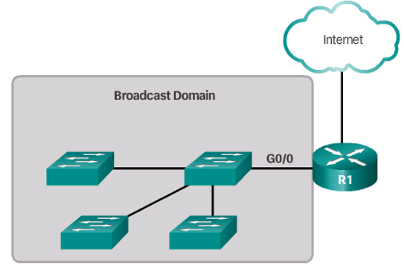
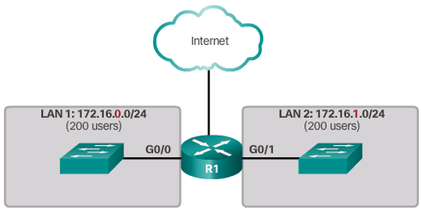
Why subnetting? – To Contain Broadcast Traffic
Problems:
Devices use broadcast to locate other devices (e.g. broadcasting ARP requests to find other hosts’ MAC addresses) or getting services (e.g. broadcasting DHCP messages to locate a DHCP server)
Broadcast
Slow network operations due to the significant amount of broadcast traffic
Slow device operations because a device must accept and process broadcast packets
Solution:
Reduce network size to create smaller broadcast domains in a process called subnetting. These smaller network spaces are called subnets.
When a router receives a broadcast, by default, it does not forward it out other interfaces, so each router interface connects a broadcast domain and broadcasts are only propagated within its specific broadcast domain
Notes:
Note: Switches propagate a broadcast frame out of all its ports except the incoming port of the broadcast frame, but routers do NOT

Slide 8
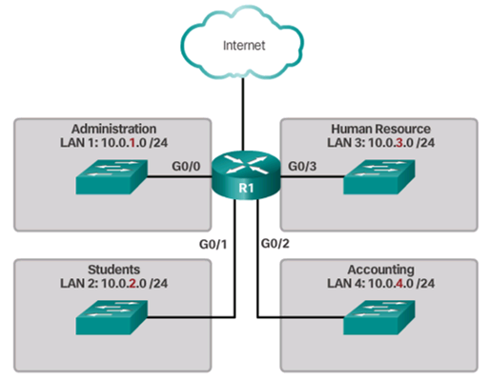

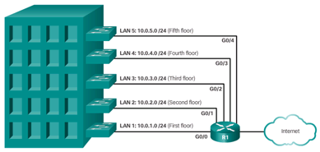
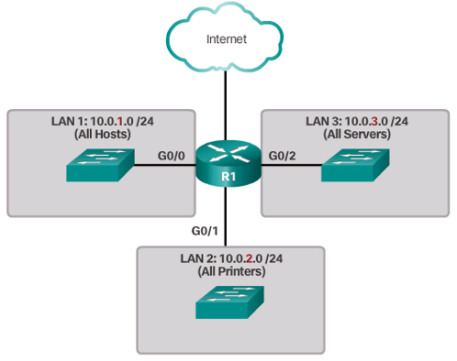
Why Subnetting? – To help Network Management
Subnetting also enables an administrator to implement network management policies, including security policies such as which subnets are allowed to communicate with each other
Can group devices and services into subnets that are determined by locations, organizational units, device types etc.

Slide 9
Is this the right way of subnetting?
Play slideshow to see animations
192 . 168 . 1. 0
192 . 168 . 1. 0
Student LAN
(subnet A)
…
Given the base network 192.168.1.0/24, we want to create two subnets, one to hold up to 100 hosts (102 addresses required as we also need the network address and broadcast address), the other up to 50 hosts (52 addresses required).
Question: Can we just take the first 102 addresses and use them for the first subnet and the next 52 addresses for the 2nd subnet, as the left diagram shows?
192 . 168 . 1. 101
192 . 168 . 1. 102
Faculty LAN
(subnet B)
…
192 . 168 . 1. 153
…
192 . 168 . 1. 255

Slide 10
Is this the right way of subnetting?
Play slideshow to see animations
The answer is: NO!
192 . 168 . 1. 0
192.168.1.00000000
192 . 168 . 1. 0
Subnet mask: 255.255.255.128, or /25
Student LAN
(subnet A)
…
…
192 . 168 . 1. 101
192.168.1.01100101
192 . 168 . 1. 102
192.168.1.01100110
Faculty LAN
(subnet B)
Subnet mask: 255.255.255.0, or /24
…
…
192 . 168 . 1. 153
192.168.1.10011001
Why? To enable proper communications:
Addresses in the same subnet must have the same network bits and different host bits
Addresses in different subnets must have different network bits.
The obtained subnets or address ranges must not overlap.
Is this solution ok?
192 . 168 . 1. 255
9

Slide 11
Is this the right way of subnetting?
Why is it wrong?
Recall that subnet mask is used to specify the number of network bits in an IP address, and all IP addresses in the same subnet must have the same number of network bits
So subnet B’s mask has to be /24, i.e. 255.255.255.0
However, this means that addresses in subnet B has the same number of network bits as IP addresses in the base network
So subnet B is in fact the base network!
This means that subnet B covers subnet A, i.e. subnets A and B overlap
We haven’t got this subnetting done properly!

Slide 12
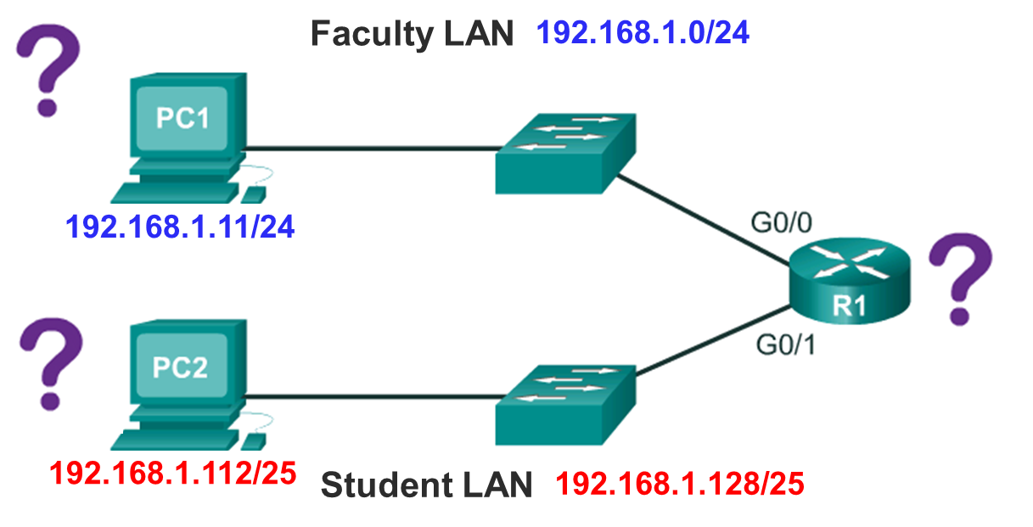
Is this the right way of subnetting?
What would happen
if we use the previously
obtained wrong subnetting solution in practice?
192.168.1.0/24
192.168.1.1/25
192.168.1.11/25
192.168.1.103/24
192.168.1.112/24
An example scenario:
PC2 sends a packet to PC1.
Firstly PC2 determines the destination network by ANDing PC1’s IP address (192.168.1.11) with its own subnetwork mask (/24) and finds out that PC1 has the same network bits as itself (192.168.1), so PC2 will send the packet out, directly to its local network, instead of asking its default gateway (G0/1 at R1) to forward the packet to the remote network. The packet can never reach PC1!

Slide 13
Creating Equal-Sized Subnets
Play slideshow to see animations
We need a systematic way to subnet. Recall the previous example: given base network:192.168.1.0/24
192. 168. 1. 0
192. 168. 1. 00000000
192. 168. 1. 1
192. 168. 1. 00000001
Observation:
1 host bit of the base network addresses is used or borrowed to identify or distinguish the 2 subnets.
Each address in a subnet contains 25 network bits (24 bits plus 1 bit borrowed from the host portion), and the subnet mask of each subnet is /25.
The two subnets are equal sized, i.e. each subnet has 128 addresses.
…
…
192. 168. 1. 62
192. 168. 1. 00111110
192. 168. 1. 63
192. 168. 1. 00111111
192. 168. 1. 0/25
192. 168. 1. 64
192. 168. 1. 01000000
192. 168. 1. 65
192. 168. 1. 01000001
…
…
…
192. 168. 1. 126
192. 168. 1. 01111110
192. 168. 1. 127
192. 168. 1. 01111111
192. 168. 1. 128
192. 168. 1. 10000000
192. 168. 1. 129
192. 168. 1. 10000001
…
…
192. 168. 1. 190
192. 168. 1. 10111110
192. 168. 1. 191
192. 168. 1. 10111111
192. 168. 1. 192
192. 168. 1. 11000000
192. 168. 1. 128/25
192. 168. 1. 193
192. 168. 1. 11000001
…
…
…
192. 168. 1. 254
192. 168. 1. 11111110
192. 168. 1. 255
192. 168. 1. 11111111

Slide 14
Creating Equal-Sized Subnets
The previous example provides us the basic idea for subnetting a given base network into equal-sized subnets :
Given a base network, borrow Host Bits to create subnets
Borrowed bits are known as subnet bits
Assign different values to these subnet bits to identify/distinguish different subnets

Slide 15
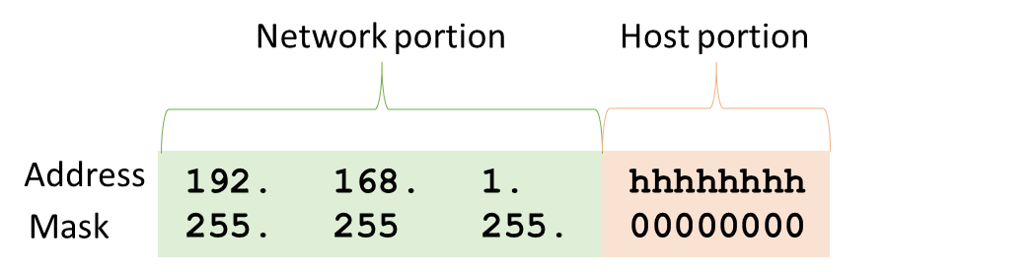
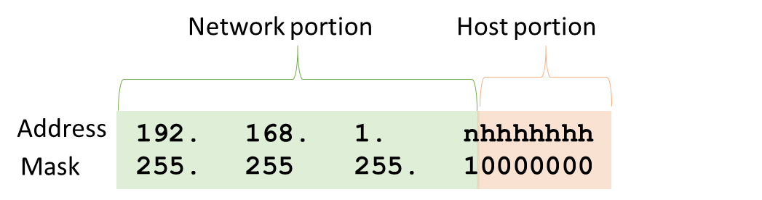
Subnetting a network into 2 equal-sized Subnets
Play slideshow to see animations
Let’s apply this idea to the previous example: given base network 192.168.1.0/24, create 2 equal-sized subnets.
Borrow 1 bit from the host portion as subnet bit.
This subnet bit (i.e. the “n” bit) can be set to 1 or 0, representing 2 different subnets
As an address in the base network contains 24 network (or subnet) bits, now adding the bit borrowed from host portion, an address in each of the 2 subnets contains 24+1=25 network bits
The subnet mask for both subnets is: 255.255.255.10000000, i.e. 255.255.55.128 when written properly in dotted decimal format, or /25 using slash notation.

Slide 16
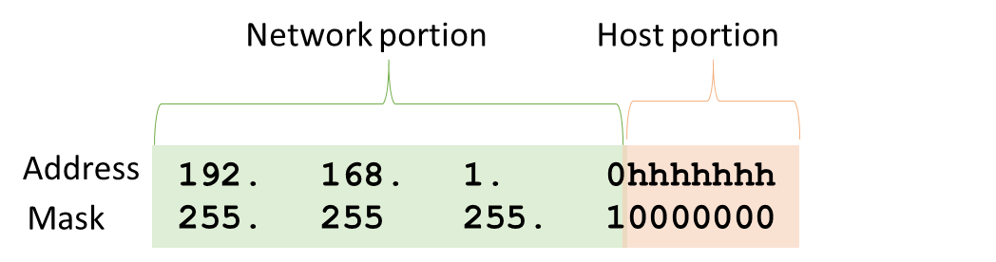
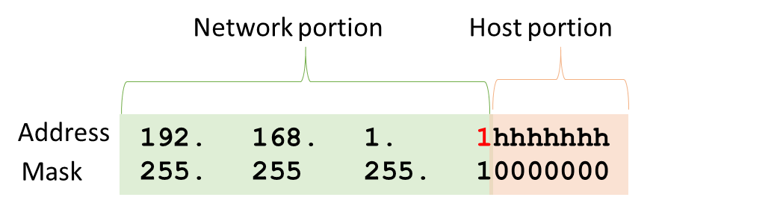
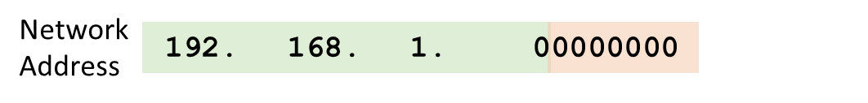

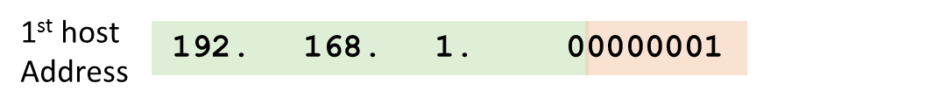
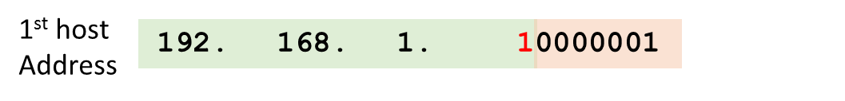
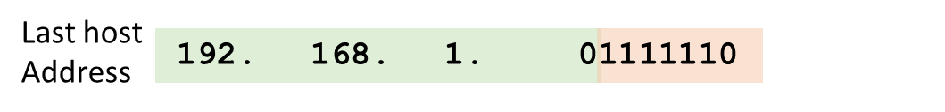
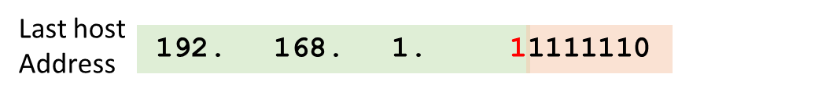
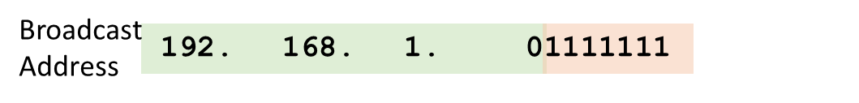
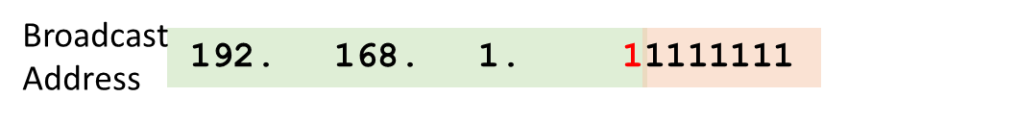
Creating 2 Equal-Sized Subnets
Play slideshow to animations
Now let’s look at the 2 subnets in detail
n=0
n=1
Subnet 0
Address range: 192.168.1.0-127. In total 128 addresses
Number of addresses can be calculated without counting – 7 host bits, giving us 2^7=128 different values/addresses
However, since network and broadcast addresses are reserved, only 126 addresses are usable host addresses
Subnet 1
Address range: 192.168.1.128-255. In total 128 addresses
7 host bits, giving us 2^7=128 different values/addresses
However, since network and broadcast addresses are reserved, only 126 addresses are usable host addresses

Slide 17
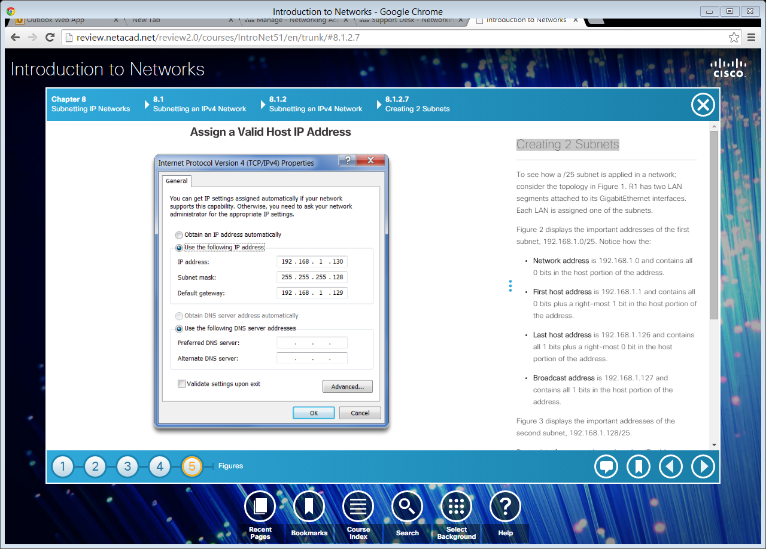
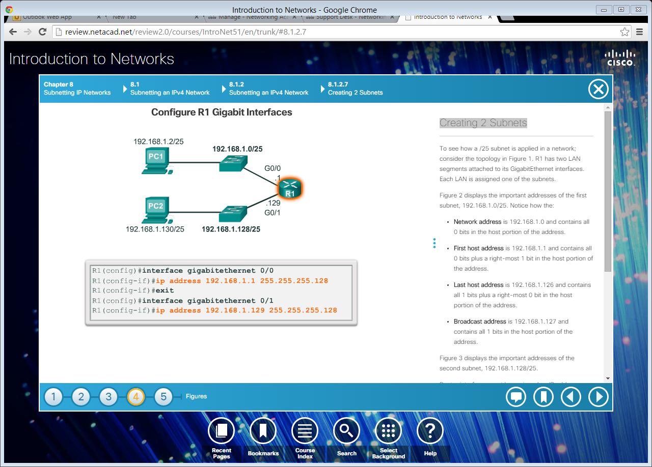
Creating 2 Equal-Sized Subnets
An implementation of the two subnets created in the previous example
Subnet 0 was assigned to the top LAN. The default gateway of the network (G0/0 of R1) was assigned the 1st usable host address of the subnet, 192.168.1.1
Subnet 1 was assigned to bottom LAN. The default gateway of the network (G0/1 of R1) was assigned the 1st usable host address of the subnet, 192.168.1.129
Don’t forget issuing the no shutdown command for both interfaces

Slide 18
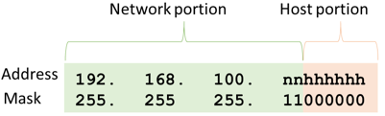
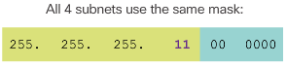
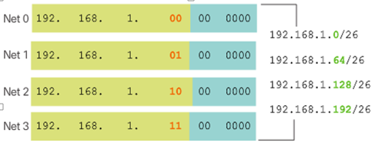
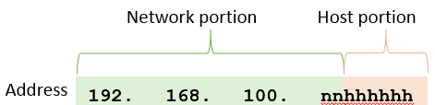
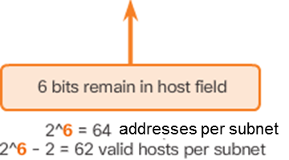
Creating 4 Equal-Sized Subnets
Play slideshow to see animations
Example:
Base network is 192.168.1.0/24, and want to create 4 equal-sized subnets
2 bits need to be borrowed to create 2² = 4 equal-sized subnets.
Network addresses of the 4 subnets:

Slide 19
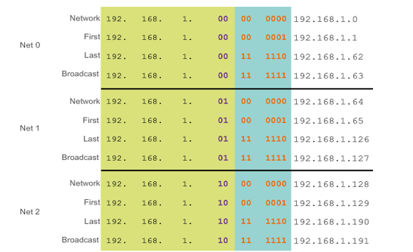
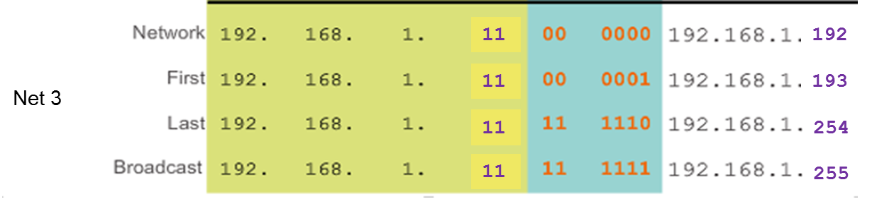
Creating 4 Equal-Sized Subnets
Address ranges of the 4 subnets

Slide 20
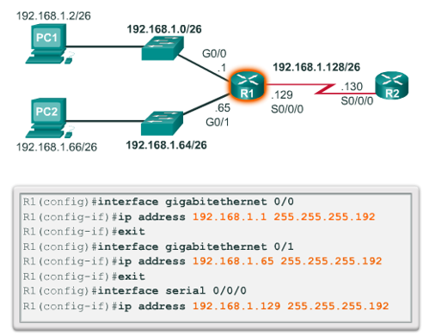
Creating 4 Equal-Sized Subnets
An implementation of the 4 subnets created in the previous example
Note that only the first 3 subnets are used, but we still had to create 4 subnets as the number of subnets created is 2^{s} (s is the number of borrowed bits), in powers of 2.
In addition to the two LANs, the WAN link (addresses) requires a subnet too, so there are 3 subnets in this topology

Slide 21
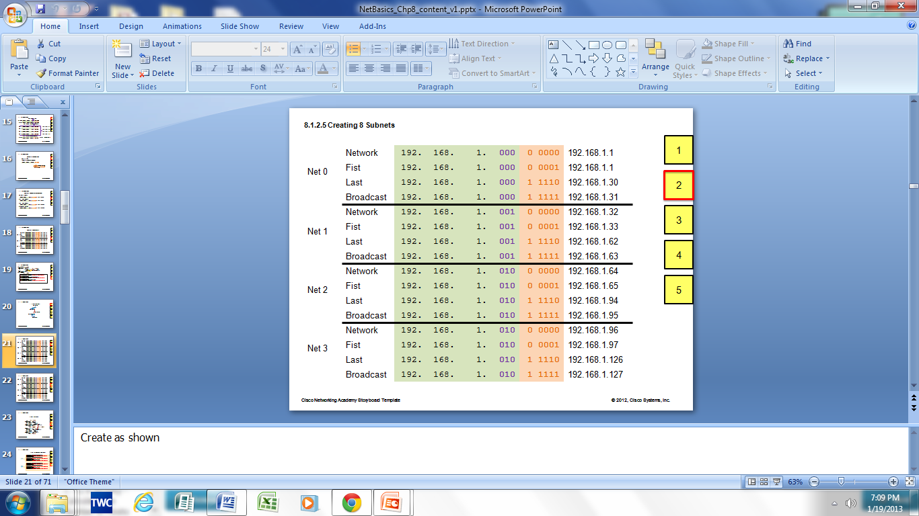
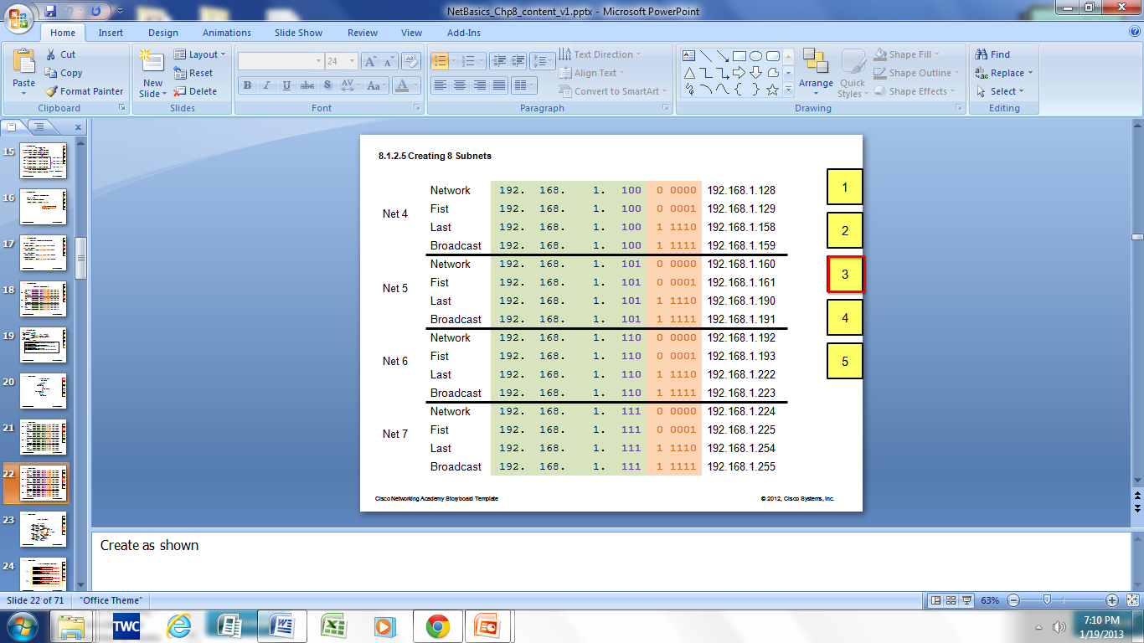
Creating 8 Equal-Sized Subnets
0
Example: Given base network 192.168.1.0/24, create 8 equal-sized subnets.
Now need to borrow 3 bits to create 8 Subnets. 2³ = 8 subnets
Subnet mask for each of the 8 subnets: /27, or 255.255.255.224
Number of addresses in each subnet: 2^5=32
Number of usable host addresses: 2^5-2=30
011
011
011
011

Slide 22
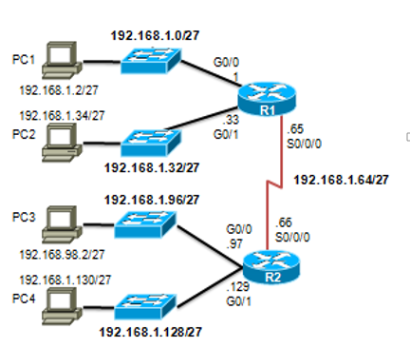
Creating 8 Equal-Sized Subnets
Example: an implementation of the subnets created in the previous example. Note that only the first 5 subnets out of the 8 are used.

Slide 23
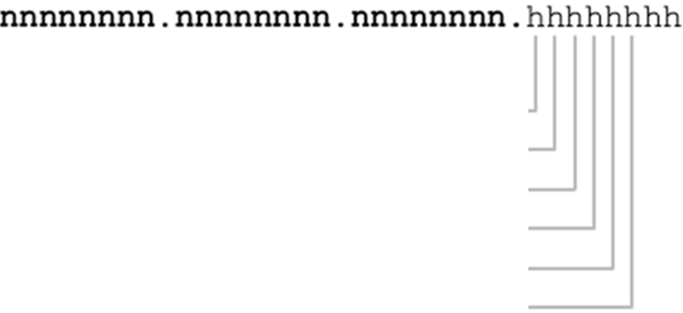
Creating Equal-Sized Subnets
More subnets created, less hosts in each created subnet
Example: base network 192.168.1.0/24
Borrowing 1 bit: 2¹=2 subnets; all with mask /25; 8-1=7 host bits remain,
2⁷-2=126 hosts in each subnet
Borrowing 2 bits: 2²=4 subnets; all with mask /26; 8-2=6 host bits remain,
2⁶-2=62 hosts in each subnet
Borrowing 3 bits: 2³=8 subnets; all with mask /27; 8-3=5 host bits remain,
2⁵-2=30 hosts in each subnet
Borrowing 4 bits: 2⁴=16 subnets; all with mask /28; 8-4=4 host bits remain,
2⁴-2=14 hosts in each subnet
Borrowing 5 bits: 2⁵=32 subnets; all with mask /29; 8-5=3 host bits remain,
2³-2=6 hosts in each subnet
Borrowing 6 bits: 2⁶=64 subnets; all with mask /30; 8-6=2 host bits remain,
2²-2=2 hosts in each subnet

Slide 24
Creating Equal-Sized Subnets - Summary
All created subnets have the same subnet mask. If the subnet mask of the given base network is /b, and s bits have been borrowed to identify the created subnets, then
Subnet mask of all created subnets is /(b+s).
When s bits are borrowed from the host portion of the addresses in the base network to create subnets, then
Number subnets created: 2^{s}
Assuming r is the number of remaining host bits after the subnet bits have been borrowed to create the subnets, then
Number of usable host addresses in a created subnet: 2^{r}-2
(same number of usable host addresses in all created subnets)

Slide 25
Creating Equal-Sized Subnets - Summary
To find out the network address of each subnet:
The network portion of the network address of a subnet contains all network bits of the base network, plus the subnet/borrowed bits (which have been given different values for different subnets)
The host portion of the network address of a subnet contains all 0s.
Then the first usable host address of a subnet is the address immediately following the network address
To get broadcast address, change all the host bits of the network address from 0s to 1s
Then the last usable host address is the address immediately prior to the broadcast address

Slide 26
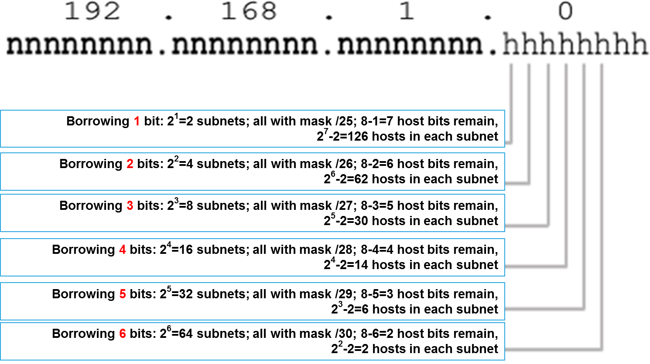
Creating 100 Subnets ?
In the examples so far, the given base network has been a /24 network, We borrowed 1 host bit to create 2 subnets, borrowed 2 bits to create 4 subnets and borrowed 3 bits to create 8 subnets
For a /24 network, at most we can only borrow 6 bits to create 2⁶ = 64 subnets. Why?
Recall that when 6 bits were borrowed to create 64 subnets, in each of the 64 subnets, there were only 2² -2=2 usable host addresses. If we were to borrow 7 hosts, there would be only 1 host bit for each subnet, i.e. 0 usable host addresses.

Slide 27
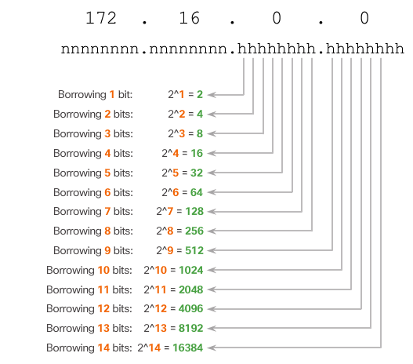
Creating 100 Subnets with a /16 Base Network
So to create 100 subnets, we need a bigger base network
If a /16 base network (e.g. 172.16.0.0/16) is used, we can borrow up to 14 host bits, thus we can create up to 2¹⁴ subnets.
To create 100 subnets, according to the formula: #subnets created = 2^{s}, s has to be 7, i.e. we need to borrow 7 host bits

Slide 28
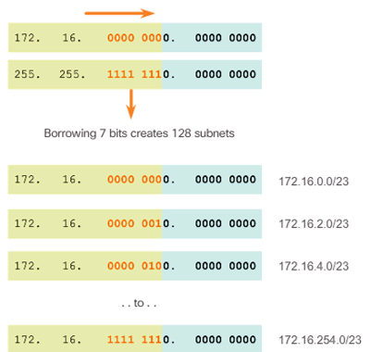
Creating 100 Subnets with a /16 Base Network
When 7 bits are borrowed, for an address in a subnet, there are (16+7) network bits, so the subnet mask for all the obtained subnets is /23
The borrowed bits can take values from 0000 000 to 1111 111, resulting in the network addresses for the 128 subnets shown below.

Slide 29
Subnetting to Meet Requirements
In practice, two considerations when planning subnets:
The number of host addresses required for each network
The number of individual subnets needed
Network administrators must devise the network addressing scheme to accommodate the maximum number of hosts for each network and the number of subnets
The addressing scheme should also allow for growth in the both the number of host addresses per subnet and the total number of subnets

Slide 30
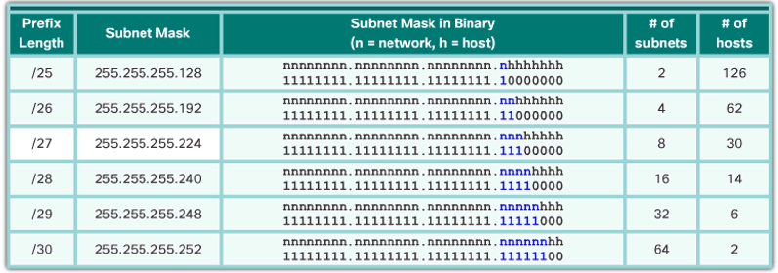
Subnetting to Meet Requirements
Given a base network, the more bits borrowed to create subnets, the fewer remaining host bits available. For example, given a /24 base network, we have:
Given a base network, when the number of hosts required in each subnet is given, the number of host addresses required in the largest subnet will determine how many bits must be left in the host portion.
For a given base network, if after borrowing bits from the host portion for creating the required number of subnets, the remaining host bits are not enough to meet the host requirement, a larger base network has to be used

Slide 31
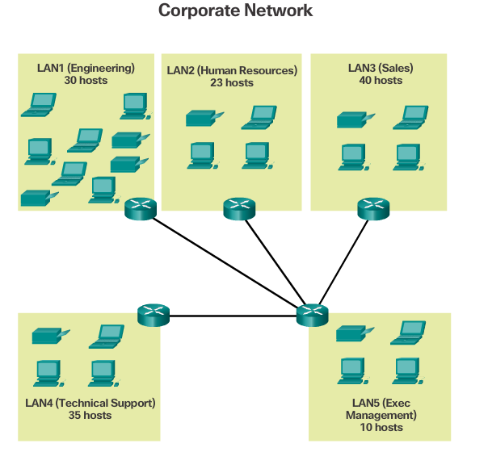
Subnetting to Meet Requirements
9 subnets required (5 LANs plus 4 links between routers) → need borrow 4 bits: 2^4=16
Largest subnet to hold 40 hosts → must have 6 host bits for the subnet: 2^6-2=62 hosts
So at least a /22 base network is required, because
The number of host bits of a /22 network is 10
So after 4 bits are borrowed, we still have 6 bits to meet the host requirement of the largest subnet

Slide 32
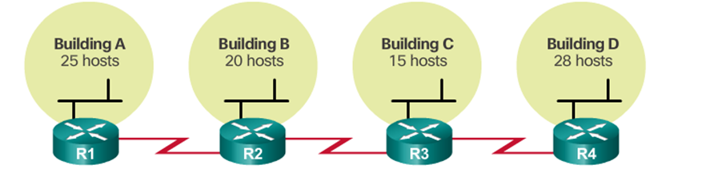
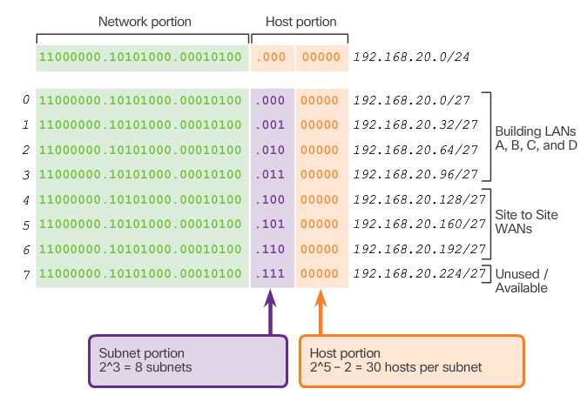
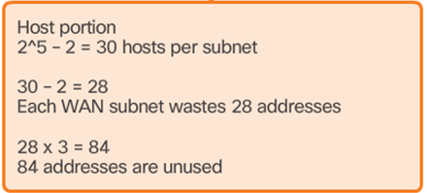
Traditional Subnetting Wastes Addresses
Traditional/basic subnetting introduced on previous slides creates equal-sized subnet, i.e. each obtained subnet has the same subnet mask
Addresses can be wasted using traditional subnetting.

Slide 33
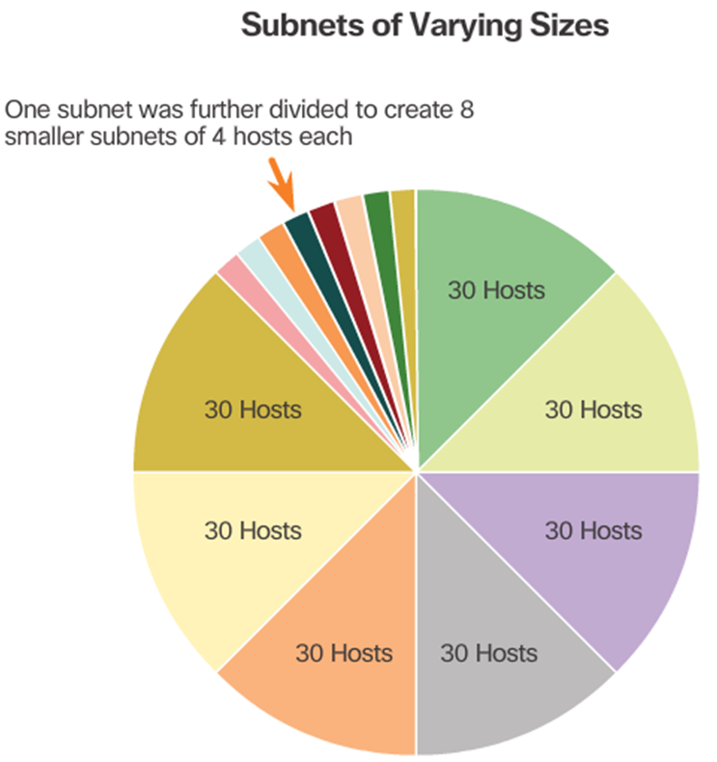
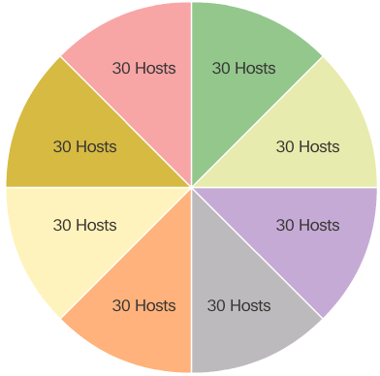
Variable Length Subnet Masks (VLSMs)
VLSM subnetting is similar to traditional subnetting:
Bits are borrowed to create subnets.
The formulas to calculate the number of hosts per subnet and the number of subnets created still apply.
The difference is that subnetting is not a single pass activity.
With VLSM, the network is first subnetted, and then the subnets are subnetted again. This process can be repeated multiple times to create subnets of various sizes.
When using VLSM, always begin by satisfying the host requirements of the largest subnet. Continue subnetting until the host requirement of the smallest subnet is satisfied.

Slide 34
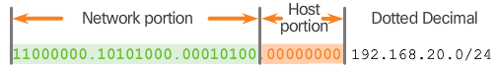
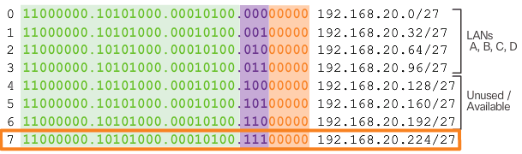
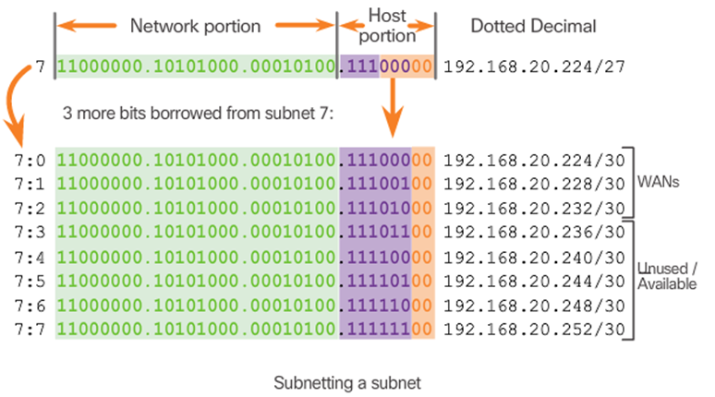
VLSM - Example
Firstly subnet the base network 192.168.20.0/24 to 8 equal-size subnets by borrowing 3 bits from the host portion:
Subnet 7 is subnetted, i.e. take subnet 7 as the base network this time, and subnet it into 8 subnets

Slide 35
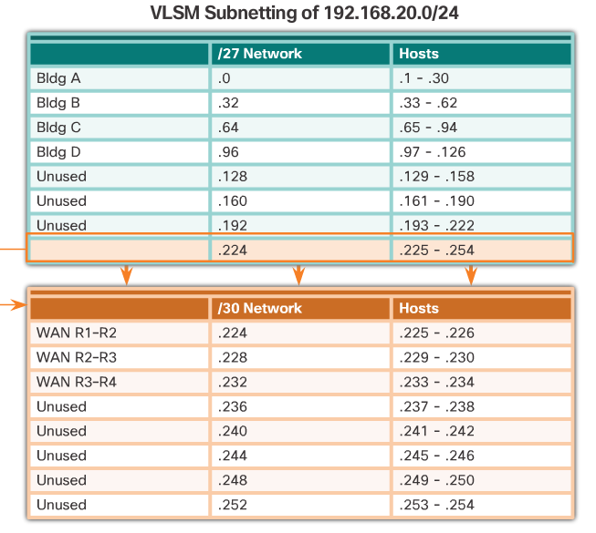
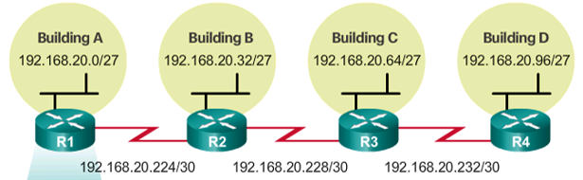
VLSM – Example (continued)

Slide 36
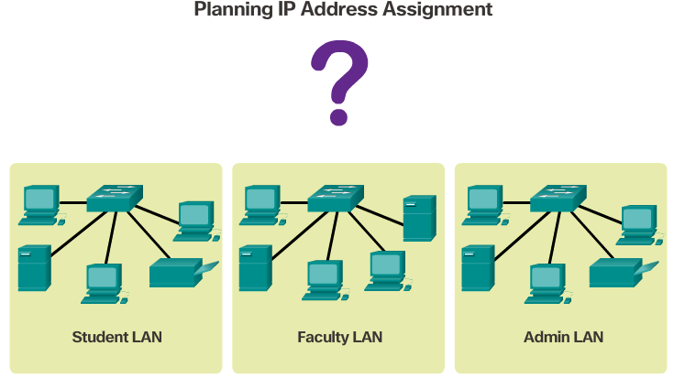
Network Address Planning
Given the limited number of available public IPv4 addresses, private IPv4 addresses are used for LANs.
Network administrator needs careful consideration to be sure that enough host addresses will be available for the currently known hosts and for future expansion.
The private IPv4 address ranges are:
10.0.0.0 - 10.255.255.255 (/8)
172.16.0.0 – 172.31.255.255 (/12)
192.168.0.0 – 192.168.255.255 (/16)
Public addresses used to connect to the Internet are typically allocated from a service provider, and is not generally the responsibility of the organization’s network administrator.
Planning requires the decision on each subnet in terms of size, the number of hosts per subnet and how host addresses will be assigned, which hosts will require static IP addresses, and which hosts can use DHCP for obtaining their addressing information.

Slide 37
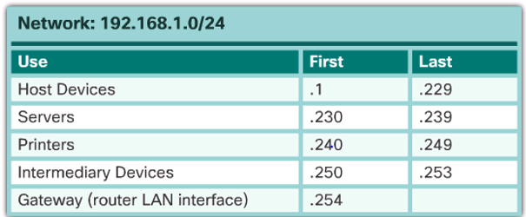
Assigning Addresses to Devices
End user clients – obtain addresses dynamically using DHCP. Changing the subnetting scheme means that the DHCP server needs to be reconfigured, and the clients must renew their IP addresses.
Servers and peripherals – Should have a predictable static IP address. Use a consistent numbering system for these devices.
Servers accessible from the Internet –In most cases, have private addresses internally, and the router or firewall at the perimeter of the network are configured to translate the internal address into a public address.
Switch SVIs – Should have predictable, statically assigned addresses.
Routers - have an IP address assigned to each router interface which serves as the gateway for the hosts in that network. Typically, the router interface uses either the lowest or highest address in the network.
An example:

